Slide 1
Baldivis Blitz
Year 11 Essentials – Practical Assessment 2

Slide 2

Opportunity to Create Your Space
Design a space here at Baldivis Secondary College for people to spend time in
Best designs will be put to a vote and the most popular will be built

Slide 3


Wait, There’s More
If this project is done well, there may be opportunity for Year 11 Students to design an outdoor space on school grounds for your year group to use in Year 12.
This Photo by Unknown Author is licensed under CC BY

Slide 4
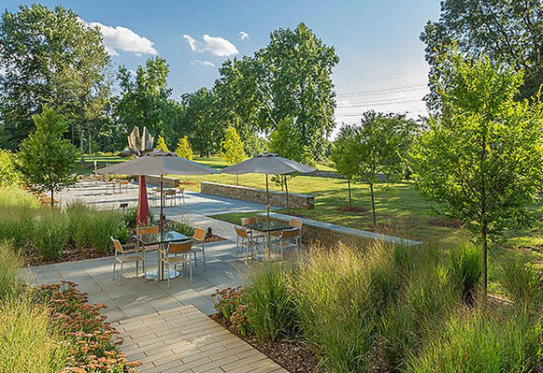
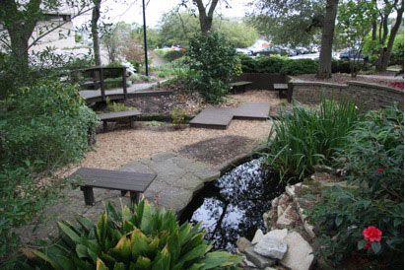
Gardens
This Photo by Unknown Author is licensed under CC BY
This Photo by Unknown Author is licensed under CC BY
Think of gardens and other spaces that you enjoy spending time in and what features they have.
Be creative.

Slide 5
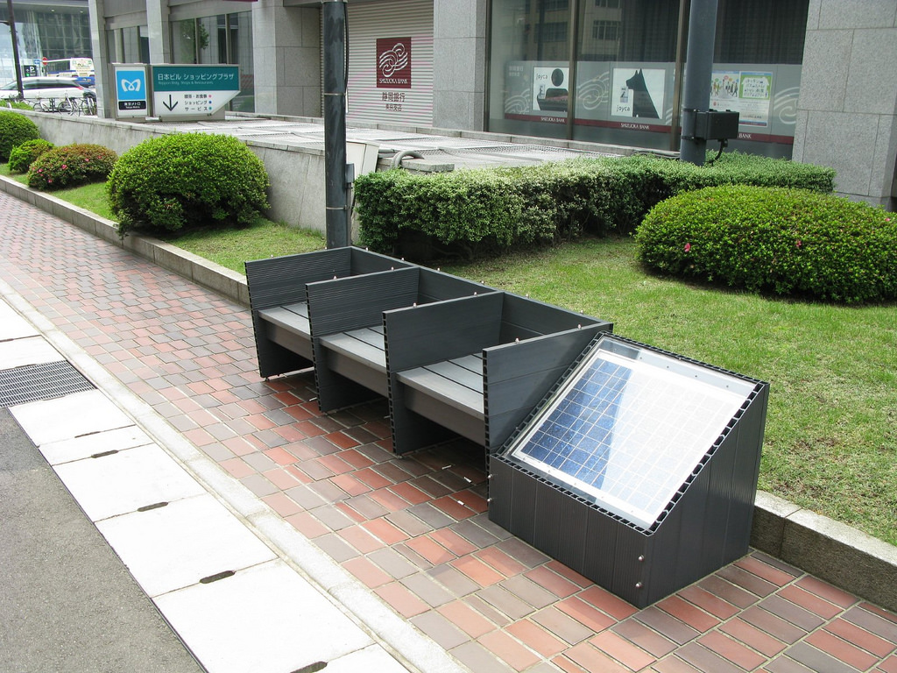
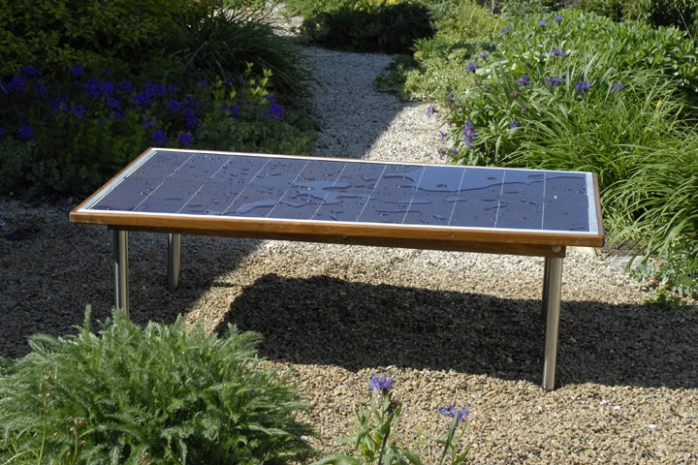
Smart Features?
This Photo by Unknown Author is licensed under CC BY-NC-SA
This Photo by Unknown Author is licensed under CC BY-NC-SA
Solar panels are becoming less expensive and being used widely. They can be placed into furniture and the electricity generated can be power other garden features or recharge devices.

Slide 6
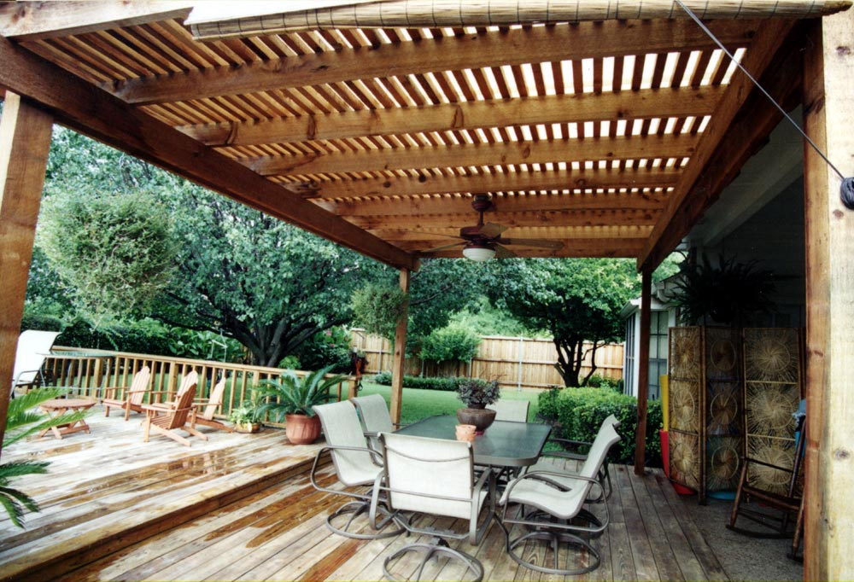
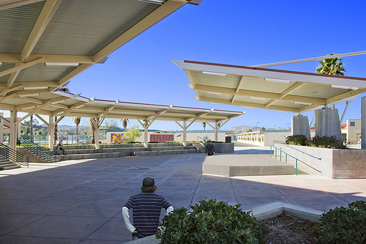
Covered Areas
This Photo by Unknown Author is licensed under CC BY-NC-ND
Covered areas are fantastic for protection against the sun, wind and rain. There are a large range of materials to use.

Slide 7
Useful Websites
https://www.bunnings.com.au
http://www.plants4perth.com.au/
http://brikmakers.com/
http://www.midlandbrick.com.au/

